Slide 1
Deadlock
Dr. Manmath N. Sahoo
Dept. of CSE, NIT Rourkela

Slide 2
Shareable vs Non-shareable resources
Sharable resources
can be used by multiple processes during their execution.
e.g., CPU, I/O bus.
Non-sharable resources
cannot be used by multiple processes during their execution.
e.g., printer

Slide 3
Static vs. Dynamic resource allocation
Static: Allocate all the required resources prior to the execution of the process.
Dynamic: Allocate only the initially required resources to start up the process; additional resources will be allocated dynamically.
Static | Dynamic
Simpler to implement Process is guaranteed to complete in definite time Resource utilization less Deadlock will never occur | Comparatively complex No certainty about the process completion Better resource utilization May lead to deadlock

Slide 4
Deadlock
Deadlock is a situation where a set of processes are blocked.
Each process in the set waits for some event from some other process in the same set.
Example #1
A system has 2 disk drives
P₁ and P₂ each hold one disk drive and each needs the other one
Example #2
Semaphores A and B, initialized to 1
P₀ P₁
wait (A); wait(B)‏
wait (B); wait(A)‏

Slide 5
Deadlock Characterization
Deadlock can arise if four conditions hold simultaneously.
Mutual exclusion: only one process at a time can use a resource
Hold and wait: a process holding at least one resource is waiting to acquire additional resources held by other processes
No preemption: a resource can be released only voluntarily by the process holding it after that process has completed its task
Circular wait: there exists a set {P₀, P₁, …, P_{n}} of waiting processes such that P₀ is waiting for a resource that is held by P₁, P₁ is waiting for a resource that is held by P₂, …, P_{n–1} is waiting for a resource that is held by P_{n}, and P_{n} is waiting for a resource that is held by P₀
Notes:
First 3 are conditions for possible deadlocks, and the 4th condition is the condition for actual deadlock.
-------------------
Circular wait
-------------------
This is actually a potential consequence of the first three.
Given that the first three conditions exist, a sequence of events may occur that lead to an unresolvable circular wait.
The unresolvable circular wait is in fact the definition of deadlock.
The circular wait listed as condition 4 is unresolvable because the first three conditions hold.
Thus, the four conditions, taken together, constitute necessary and sufficient conditions for deadlock.

Slide 6
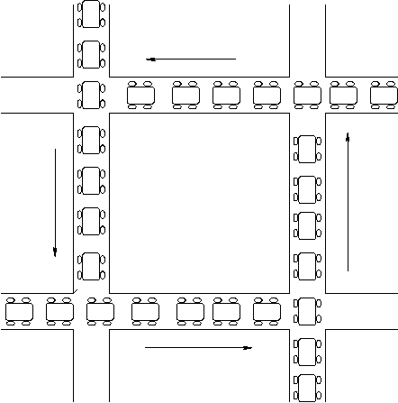

Slide 7
Deadlock Characterization
First 3 are conditions for possible deadlocks, and the 4th condition is the condition for actual deadlock.
Circular wait is actually a potential consequence of the first three.
Given that the first three conditions exist, a sequence of events may occur that lead to an unresolvable circular wait.
The unresolvable circular wait is in fact the definition of deadlock.
The circular wait listed as condition 4 is unresolvable because the first three conditions hold.
Thus, the four conditions, taken together, constitute necessary and sufficient conditions for deadlock.

Slide 8
Methods for Handling Deadlocks
Prevention
Ensure that the system will never enter a deadlock state
Avoidance
Ensure that the system will never enter an unsafe state
Detection
Allow the system to enter a deadlock state and then recover

Slide 9
Deadlock Prevention
Restrain at least one of the causes of deadlock
Mutual Exclusion – The mutual-exclusion condition must hold for non-sharable resources.
Hold and Wait – we must guarantee that whenever a process requests a resource, it does not hold any other resources
There is no guarantee that a file that is released by a process will be in the same state when it will get for the next time.

Slide 10
Deadlock Prevention
No Preemption
If a process that is holding some resources requests another resource that cannot be immediately allocated to it, then all resources currently being held are preempted.
Preempted resources are added to the list of available resources.
A process will be restarted only when it can regain its old resources, and the new ones that it is requesting

Slide 11
Deadlock Prevention
Circular Wait
impose a total ordering of all resource types, and require that each process requests resources in an increasing order of enumeration. For example:
R1
R2
R3
R4
If P_{i} holds R3 and requests for R2 then it has release R3 first and re-request for R2 then R3
What if R3 is a file!!

Slide 12
Deadlock Avoidance and Safe State
When a process requests an available resource, the system must decide if immediate allocation leaves the system in a safe state
A system is in a safe state only if there exists a safe sequence of execution
Total number of resources=12
P0 requests one more resource dynamically. Can it be granted?
<P1,P2,P0> is a safe sequence of execution
Process | Max Needs | Allocated | Current Needs
P0 | 10 | 5 | 5
P1 | 4 | 2 | 2
P2 | 7 | 3 | 4
Process | Max Needs | Allocated | Current Needs
P0 | 10 | 4 | 6
P1 | 4 | 2 | 2
P2 | 7 | 3 | 4

Slide 13
Safe State (continued)‏
If a system is in safe state ⇒ no deadlocks
If a system is in unsafe state ⇒ possibility of deadlock
Avoidance ⇒ ensure that a system will never enter an unsafe state

Slide 14
Safe, Unsafe, Deadlock State
Deadlock
Unsafe
Safe

Slide 15
Avoidance algorithms
For a single instance of a resource type, use a resource-allocation graph (RAG)
For multiple instances of a resource type, use the banker’s algorithm

Slide 16
RAG for Deadlock avoidance
G = ( V, E )
V: Processes and Resources
E: Request edge, Allocation edge, Claim edge
Process:
Claim edge: Resource:
Request edge:
Assignment edge:
P_{i}
P_{i}
R_{j}
R_{j}
P_{i}
R_{j}
P_{i}
R_{j}

Slide 17
RAG for Deadlock avoidance
Claim edge P_{i} R_{j} indicates that process P_{i} may request resource R_{j}; which is represented by a dashed line
A claim edge converts to a request edge when a process requests a resource
A request edge converts to an assignment edge when the resource is allocated to the process

Slide 18
RAG for Deadlock avoidance
Assignment
edge
R₁
Request
edge
P₁
P₂
Claim
edge
Claim
edge
R₂

Slide 19
RAG for Deadlock avoidance
Assignment
edge
R₁
Request
edge
P₁
P₂
Claim
edge
Request
edge
R₂
Notes:
Q: Until R1 is not assigned to P2, P2 cant proceed through its execution. Then how it requests for R2?
Ans: For an operation if P2 requires both the resources (e.g., print operation requires a FILE (R1) and a PRINTER (R2)) then it requests OS for both at a time. OS can check them in any order. In this example, request for R1 first, which in not available. This does not mean that OS will not check for other requested resources.

Slide 20
RAG for Deadlock avoidance
Presence of Cycle in RAG may lead to DEADLOCK
Assignment
edge
R₁
Request
edge
P₁
P₂
Claim
edge
Assignment
edge
R₂

Slide 21
RAG for Deadlock avoidance
Suppose that process P_{i} requests a resource R_{j}
The request can be granted only if converting the request edge to an assignment edge does not result in the formation of a cycle in the resource allocation graph

Slide 22
RAG for Deadlock avoidance
RAG algorithm doesn’t work for multiple instances of resources.
R₁
Assignment
edge
Request
edge
P₁
P₂
Claim
edge
Assignment
edge
R₂

Slide 23
Banker’s Algorithm
When a process makes a request for a set of resources,
Resource Request Algorithm:
assume that the request is granted,
Update the system state accordingly,
Then, determine if the result is a safe state (Safety algo)
If so, grant the request
if not, block the process until it is safe to grant the request.

Slide 24
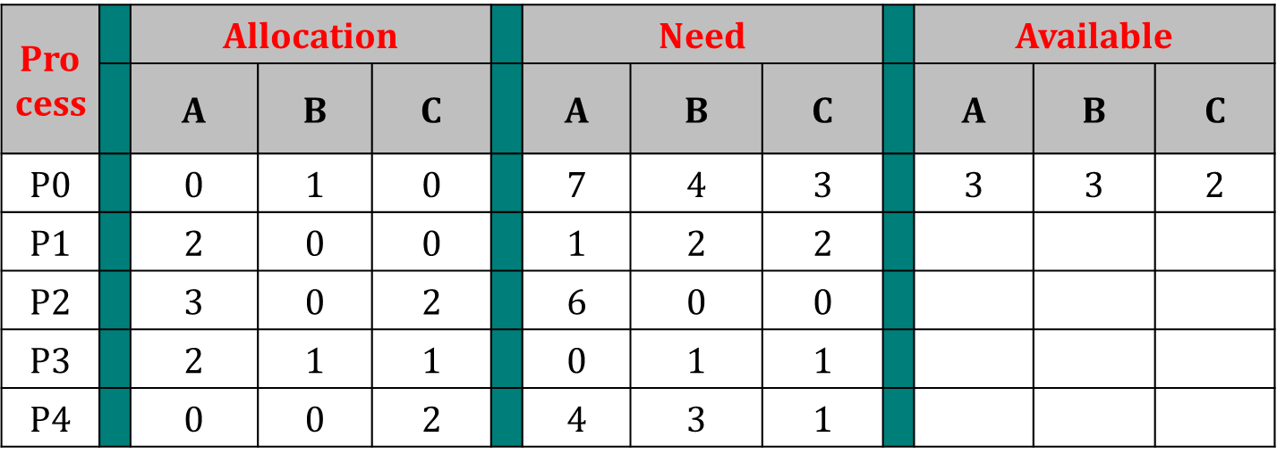
Data Structures for the Banker’s Algorithm
Let n = number of processes, and m = number of resources types.
Available: Vector of length m. If Available [j] = k, there are k instances of resource type R_{j} available.
Max: n x m matrix. If Max [i,j] = k, then process P_{i} may request at most k instances of resource type R_{j}.
Allocation: n x m matrix. If Allocation[i,j] = k then P_{i} is currently allocated k instances of R_{j.}
Need: n x m matrix. If Need[i,j] = k, then P_{i} may need k more instances of R_{j} to complete its task. Need [i,j] = Max[i,j] – Allocation [i,j]

Slide 25
Banker’s Algorithm
When P_{i} makes a Request_{i}
Resource Request Algotrihtm
1. If Request_{i} <= Need_{i} then goto step2
else error
2. If Request_{i} <= Available then goto step3
else wait
3. Available = Available – Request_{i}
Allocation_{i}= Allocation_{i} + Request_{i}
Need_{i} = Need_{i} – Request_{i}
4. Check if the new state is safe (Safety Algo)
If so, grant the request
if not, block the process until it is safe to grant the request.
System pretends to have allocated resources

Slide 26
Safety Algorithm
1. Initialize Work = Available
Initialize Finish[i] = False, for i = 1,2,3,..n
2. Find an i such that:
Finish[i] == False and Need[i] <= Work
If no such i exists, go to step 4.
3. Work = Work + Allocation[i]
Finish[i] = True
goto step 2
4. if Finish[i] == True for all i, then the system is in a safe state.

Slide 27
Banker’s Algorithm
Safety Algotrihtm
1. Initialize Work = Available
Initialize Finish[i] = False, for i = 1,2,3,..n
2. Find an i such that:
Finish[i] == False and Need[i] <= Work
If no such i exists, go to step 4.
3. Work = Work + Allocation[i]
Finish[i] = True
goto step 2
if Finish[i] == True for all i, then the system is in a safe state.
5. Return

Slide 28
Banker’s Algorithm: Example-1
A B C
Initially Available=[10, 5, 7]
Request₁ <= Need₁: Yes
Request₁<=Available: Yes
System pretends allocation of Reqest₁
Process |  | Allocation |  |  |  | Need
 |  | A | B | C |  | A | B | C
P0 |  | 0 | 1 | 0 |  | 7 | 4 | 3
P1 |  | 2 | 0 | 0 |  | 1 | 2 | 2
P2 |  | 3 | 0 | 2 |  | 6 | 0 | 0
P3 |  | 2 | 1 | 1 |  | 0 | 1 | 1
P4 |  | 0 | 0 | 2 |  | 4 | 3 | 1
Available = [3 3 2]
P1 makes Request₁ = (1,0,2)

Slide 29
Banker’s Algorithm: Example-1
Updated State.
Let’s check for a safe sequence by calling safety algo.
Work=[2 3 0]
Finish=[F F F F F]
P1: Finish[1]=T;
Work = [5 3 2]
P3: Finish[3]=T;
Work = [7 4 3]
P4: Finish[4]=T;
Work = [7 4 5]
P0: Finish[0]=T;
Work = [7 5 5]
P2: Finish[2]=T;
Work = [10 5 7]
Safe Sequence exists: <P1,P3,P4,P0,P2>
Process |  | Allocation |  |  |  | Need
 |  | A | B | C |  | A | B | C
P0 |  | 0 | 1 | 0 |  | 7 | 4 | 3
P1 |  | 3 | 0 | 2 |  | 0 | 2 | 0
P2 |  | 3 | 0 | 2 |  | 6 | 0 | 0
P3 |  | 2 | 1 | 1 |  | 0 | 1 | 1
P4 |  | 0 | 0 | 2 |  | 4 | 3 | 1
P0 |  | 0 | 0 | 0 |  | 0 | 0 | 0
P1 |  | 0 | 0 | 0 |  | 0 | 0 | 0
P2 |  | 0 | 0 | 0 |  | 0 | 0 | 0
P3 |  | 0 | 0 | 0 |  | 0 | 0 | 0
P4 |  | 0 | 0 | 0 |  | 0 | 0 | 0
Available = [2 3 0]

Slide 30
Banker’s Algorithm: Example
Updated State.
Let’s check for a safe sequence.
Process |  | Allocation |  |  |  | Need |  |  |  | Available
 |  | A | B | C |  | A | B | C |  | A | B | C
P0 |  | 0 | 1 | 0 |  | 7 | 4 | 3 |  | 2 | 3 | 0
P1 |  | 3 | 0 | 2 |  | 0 | 2 | 0
P2 |  | 3 | 0 | 2 |  | 6 | 0 | 0
P3 |  | 2 | 1 | 1 |  | 0 | 1 | 1
P4 |  | 0 | 0 | 2 |  | 4 | 3 | 1
P1 makes Request₁ = (1,0,2)

Slide 31
Banker’s Algorithm: Example
P1 can be completed.
Process |  | Allocation |  |  |  | Need |  |  |  | Available
 |  | A | B | C |  | A | B | C |  | A | B | C
P0 |  | 0 | 1 | 0 |  | 7 | 4 | 3 |  | 5 | 3 | 2
P1 |  | 0 | 0 | 0 |  | 0 | 0 | 0
P2 |  | 3 | 0 | 2 |  | 6 | 0 | 0
P3 |  | 2 | 1 | 1 |  | 0 | 1 | 1
P4 |  | 0 | 0 | 2 |  | 4 | 3 | 1
P1 makes Request₁ = (1,0,2)

Slide 32
Banker’s Algorithm: Example
P3 can be completed.
Process |  | Allocation |  |  |  | Need |  |  |  | Available
 |  | A | B | C |  | A | B | C |  | A | B | C
P0 |  | 0 | 1 | 0 |  | 7 | 4 | 3 |  | 7 | 4 | 3
P1 |  | 0 | 0 | 0 |  | 0 | 0 | 0
P2 |  | 3 | 0 | 2 |  | 6 | 0 | 0
P3 |  | 0 | 0 | 0 |  | 0 | 0 | 0
P4 |  | 0 | 0 | 2 |  | 4 | 3 | 1
P1 makes Request₁ = (1,0,2)

Slide 33
Banker’s Algorithm: Example
P4 can be completed.
Process |  | Allocation |  |  |  | Need |  |  |  | Available
 |  | A | B | C |  | A | B | C |  | A | B | C
P0 |  | 0 | 1 | 0 |  | 7 | 4 | 3 |  | 7 | 4 | 5
P1 |  | 0 | 0 | 0 |  | 0 | 0 | 0
P2 |  | 3 | 0 | 2 |  | 6 | 0 | 0
P3 |  | 0 | 0 | 0 |  | 0 | 0 | 0
P4 |  | 0 | 0 | 0 |  | 0 | 0 | 0
P1 makes Request₁ = (1,0,2)

Slide 34
Banker’s Algorithm: Example
P0 can be completed.
Process |  | Allocation |  |  |  | Need |  |  |  | Available
 |  | A | B | C |  | A | B | C |  | A | B | C
P0 |  | 0 | 0 | 0 |  | 0 | 0 | 0 |  | 7 | 5 | 5
P1 |  | 0 | 0 | 0 |  | 0 | 0 | 0
P2 |  | 3 | 0 | 2 |  | 6 | 0 | 0
P3 |  | 0 | 0 | 0 |  | 0 | 0 | 0
P4 |  | 0 | 0 | 0 |  | 0 | 0 | 0
P1 makes Request₁ = (1,0,2)

Slide 35
Banker’s Algorithm: Example
P2 can be completed.
Process |  | Allocation |  |  |  | Need |  |  |  | Available
 |  | A | B | C |  | A | B | C |  | A | B | C
P0 |  | 0 | 0 | 0 |  | 0 | 0 | 0 |  | 10 | 5 | 7
P1 |  | 0 | 0 | 0 |  | 0 | 0 | 0
P2 |  | 0 | 0 | 0 |  | 0 | 0 | 0
P3 |  | 0 | 0 | 0 |  | 0 | 0 | 0
P4 |  | 0 | 0 | 0 |  | 0 | 0 | 0
P1 makes Request₁ = (1,0,2)

Slide 36
Banker’s Algorithm: Example
Safe Sequence: <P1,P3,P4,P0,P2>
Process |  | Allocation |  |  |  | Need |  |  |  | Available
 |  | A | B | C |  | A | B | C |  | A | B | C
P0 |  | 0 | 1 | 0 |  | 7 | 4 | 3 |  | 2 | 3 | 0
P1 |  | 3 | 0 | 2 |  | 0 | 2 | 0
P2 |  | 3 | 0 | 2 |  | 6 | 0 | 0
P3 |  | 2 | 1 | 1 |  | 0 | 1 | 1
P4 |  | 0 | 0 | 2 |  | 4 | 3 | 1
P1 makes Request₁ = (1,0,2) --> GRANTED

Slide 37
Banker’s Algorithm: Example
Process |  | Allocation |  |  |  | Need |  |  |  | Available
 |  | A | B | C |  | A | B | C |  | A | B | C
P0 |  | 0 | 1 | 0 |  | 7 | 4 | 3 |  | 2 | 3 | 0
P1 |  | 3 | 0 | 2 |  | 0 | 2 | 0
P2 |  | 3 | 0 | 2 |  | 6 | 0 | 0
P3 |  | 2 | 1 | 1 |  | 0 | 1 | 1
P4 |  | 0 | 0 | 2 |  | 4 | 3 | 1
Now, P4 makes Request₄ = (3,3,0) --> NOT AVAILABLE

Slide 38
Banker’s Algorithm: Example
Process |  | Allocation |  |  |  | Need |  |  |  | Available
 |  | A | B | C |  | A | B | C |  | A | B | C
P0 |  | 0 | 1 | 0 |  | 7 | 4 | 3 |  | 2 | 3 | 0
P1 |  | 3 | 0 | 2 |  | 0 | 2 | 0
P2 |  | 3 | 0 | 2 |  | 6 | 0 | 0
P3 |  | 2 | 1 | 1 |  | 0 | 1 | 1
P4 |  | 0 | 0 | 2 |  | 4 | 3 | 1
Now, P0 makes Request₀ = (0,2,0)

Slide 39
Banker’s Algorithm: Example
Updated State.
Let’s check for a safe sequence.
Process |  | Allocation |  |  |  | Need |  |  |  | Available
 |  | A | B | C |  | A | B | C |  | A | B | C
P0 |  | 0 | 3 | 0 |  | 7 | 2 | 3 |  | 2 | 1 | 0
P1 |  | 3 | 0 | 2 |  | 0 | 2 | 0
P2 |  | 3 | 0 | 2 |  | 6 | 0 | 0
P3 |  | 2 | 1 | 1 |  | 0 | 1 | 1
P4 |  | 0 | 0 | 2 |  | 4 | 3 | 1
Now, P0 makes Request₀ = (0,2,0)

Slide 40
Banker’s Algorithm: Example
No process can complete
Process |  | Allocation |  |  |  | Need |  |  |  | Available
 |  | A | B | C |  | A | B | C |  | A | B | C
P0 |  | 0 | 3 | 0 |  | 7 | 2 | 3 |  | 2 | 1 | 0
P1 |  | 3 | 0 | 2 |  | 0 | 2 | 0
P2 |  | 3 | 0 | 2 |  | 6 | 0 | 0
P3 |  | 2 | 1 | 1 |  | 0 | 1 | 1
P4 |  | 0 | 0 | 2 |  | 4 | 3 | 1
Now, P0 makes Request₀ = (0,2,0)--> NOT GRANTED

Slide 41
Banker’s Algorithm: Example
Revert back to previous state
Process |  | Allocation |  |  |  | Need |  |  |  | Available
 |  | A | B | C |  | A | B | C |  | A | B | C
P0 |  | 0 | 1 | 0 |  | 7 | 4 | 3 |  | 2 | 3 | 0
P1 |  | 3 | 0 | 2 |  | 0 | 2 | 0
P2 |  | 3 | 0 | 2 |  | 6 | 0 | 0
P3 |  | 2 | 1 | 1 |  | 0 | 1 | 1
P4 |  | 0 | 0 | 2 |  | 4 | 3 | 1
Disadvantage: Time complexity is very high.

Slide 42
Deadlock Detection and Recovery
An algorithm that examines the state of the system to detect whether a deadlock has occurred
And an algorithm to recover from the deadlock

Slide 43
Deadlock Detection: Single Instance of Each Resource Type
Requires the creation and maintenance of a wait for graph (WFG)
variant of the resource-allocation graph
The graph is obtained by removing the resource nodes from a RAG and collapsing the appropriate edges
Consequently; all nodes are processes
P_{i} →P_{j} if P_{i} is waiting for P_{j}
Periodically invoke an algorithm that searches for a cycle in the graph
If there is a cycle, there exists a deadlock
An algorithm to detect a cycle in a graph requires an O(n + e) operations, where n is the number of vertices in the graph

Slide 44
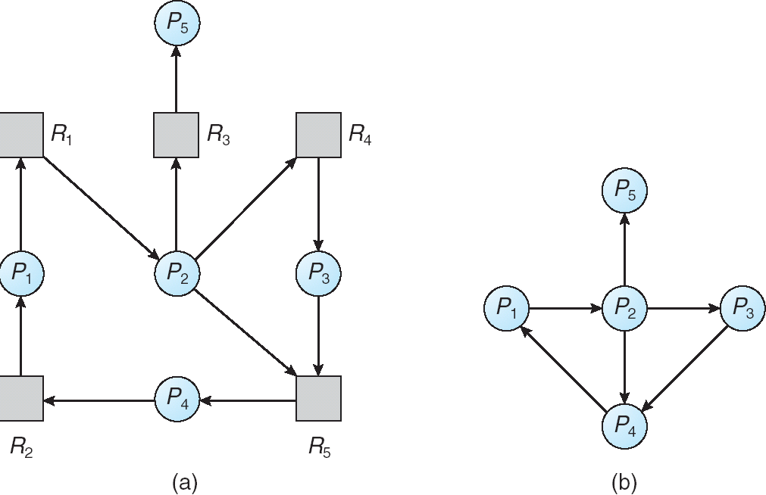
Deadlock Detection: Single Instance of Each Resource Type
Resource-Allocation Graph
Corresponding wait-for graph

Slide 45
Deadlock Detection: Multiple Instances of Resource Types
Variation of Banker’s Algorithm
1. Initialize Work = Available
Initialize Finish[i] = False, for i = 1,2,3,..n
2. Find an i such that:
Finish[i] == False and Request[i] <= Work
If no such i exists, go to step 4.
3. Work = Work + Allocation[i]
Finish[i] = True
goto step 2
4. if Finish[i] == true for all i, then the system is not in deadlocked state

Slide 46
Deadlock Detection Algorithm: Example
Sequence <P0, P2, P3, P1, P4> results in Finish[i] == true for all i
⇒ System is not in deadlocked state
Process |  | Allocation |  |  |  | Request |  |  |  | Available
 |  | A | B | C |  | A | B | C |  | A | B | C
P0 |  | 0 | 1 | 0 |  | 0 | 0 | 0 |  | 0 | 0 | 0
P1 |  | 2 | 0 | 0 |  | 2 | 0 | 2
P2 |  | 3 | 0 | 3 |  | 0 | 0 | 1
P3 |  | 2 | 1 | 1 |  | 1 | 0 | 0
P4 |  | 0 | 0 | 2 |  | 0 | 0 | 2

Slide 47
Deadlock Detection Algorithm: Example
Finish[0] is Ture but P1, P2, P3, P4 are deadlocked.
Process |  | Allocation |  |  |  | Request |  |  |  | Available
 |  | A | B | C |  | A | B | C |  | A | B | C
P0 |  | 0 | 1 | 0 |  | 0 | 0 | 0 |  | 0 | 0 | 0
P1 |  | 2 | 0 | 0 |  | 2 | 0 | 2
P2 |  | 3 | 0 | 3 |  | 0 | 0 | 1
P3 |  | 2 | 1 | 1 |  | 1 | 0 | 0
P4 |  | 0 | 0 | 2 |  | 0 | 0 | 2

Slide 48
Recovery from Deadlock
Two Approaches
Process termination
Resource preemption

Slide 49
Recovery from Deadlock: Process Termination
Abort all deadlocked processes
This approach will break the deadlock, but at great expense
Abort one process at a time until the deadlock cycle is eliminated
This approach incurs considerable overhead, since, after each process is aborted, a deadlock-detection algorithm must be re-invoked to determine whether any processes are still deadlocked
Many factors may affect which process is chosen for termination
What is the priority of the process?
How long has the process run so far and how much longer will the process need to run before completing its task?
How many and what type of resources has the process used?
How many more resources does the process need in order to finish its task?
How many processes will need to be terminated?

Slide 50
Recovery from Deadlock: Resource Preemption
With this approach, we successively preempt some resources from processes and give these resources to other processes until the deadlock cycle is broken
When preemption is required to deal with deadlocks, then three issues need to be addressed:
Selecting a victim – Which resources and which processes are to be preempted?
Rollback – If we preempt a resource from a process, what should be done with that process?
Starvation – How do we ensure that starvation will not occur? That is, how can we guarantee that resources will not always be preempted from the same process?

Slide 51
Summary
Both deadlock avoidance and deadlock detection and recovery are expensive
Do nothing: ignore the problem altogether and pretend that deadlocks never occur in the system (used by Windows and Unix)‏
System administrator/user will restart the processes

